Slide 1
Open Streets Final Project
File created on: 3/10/2022 2:11:16 AM

Slide 2
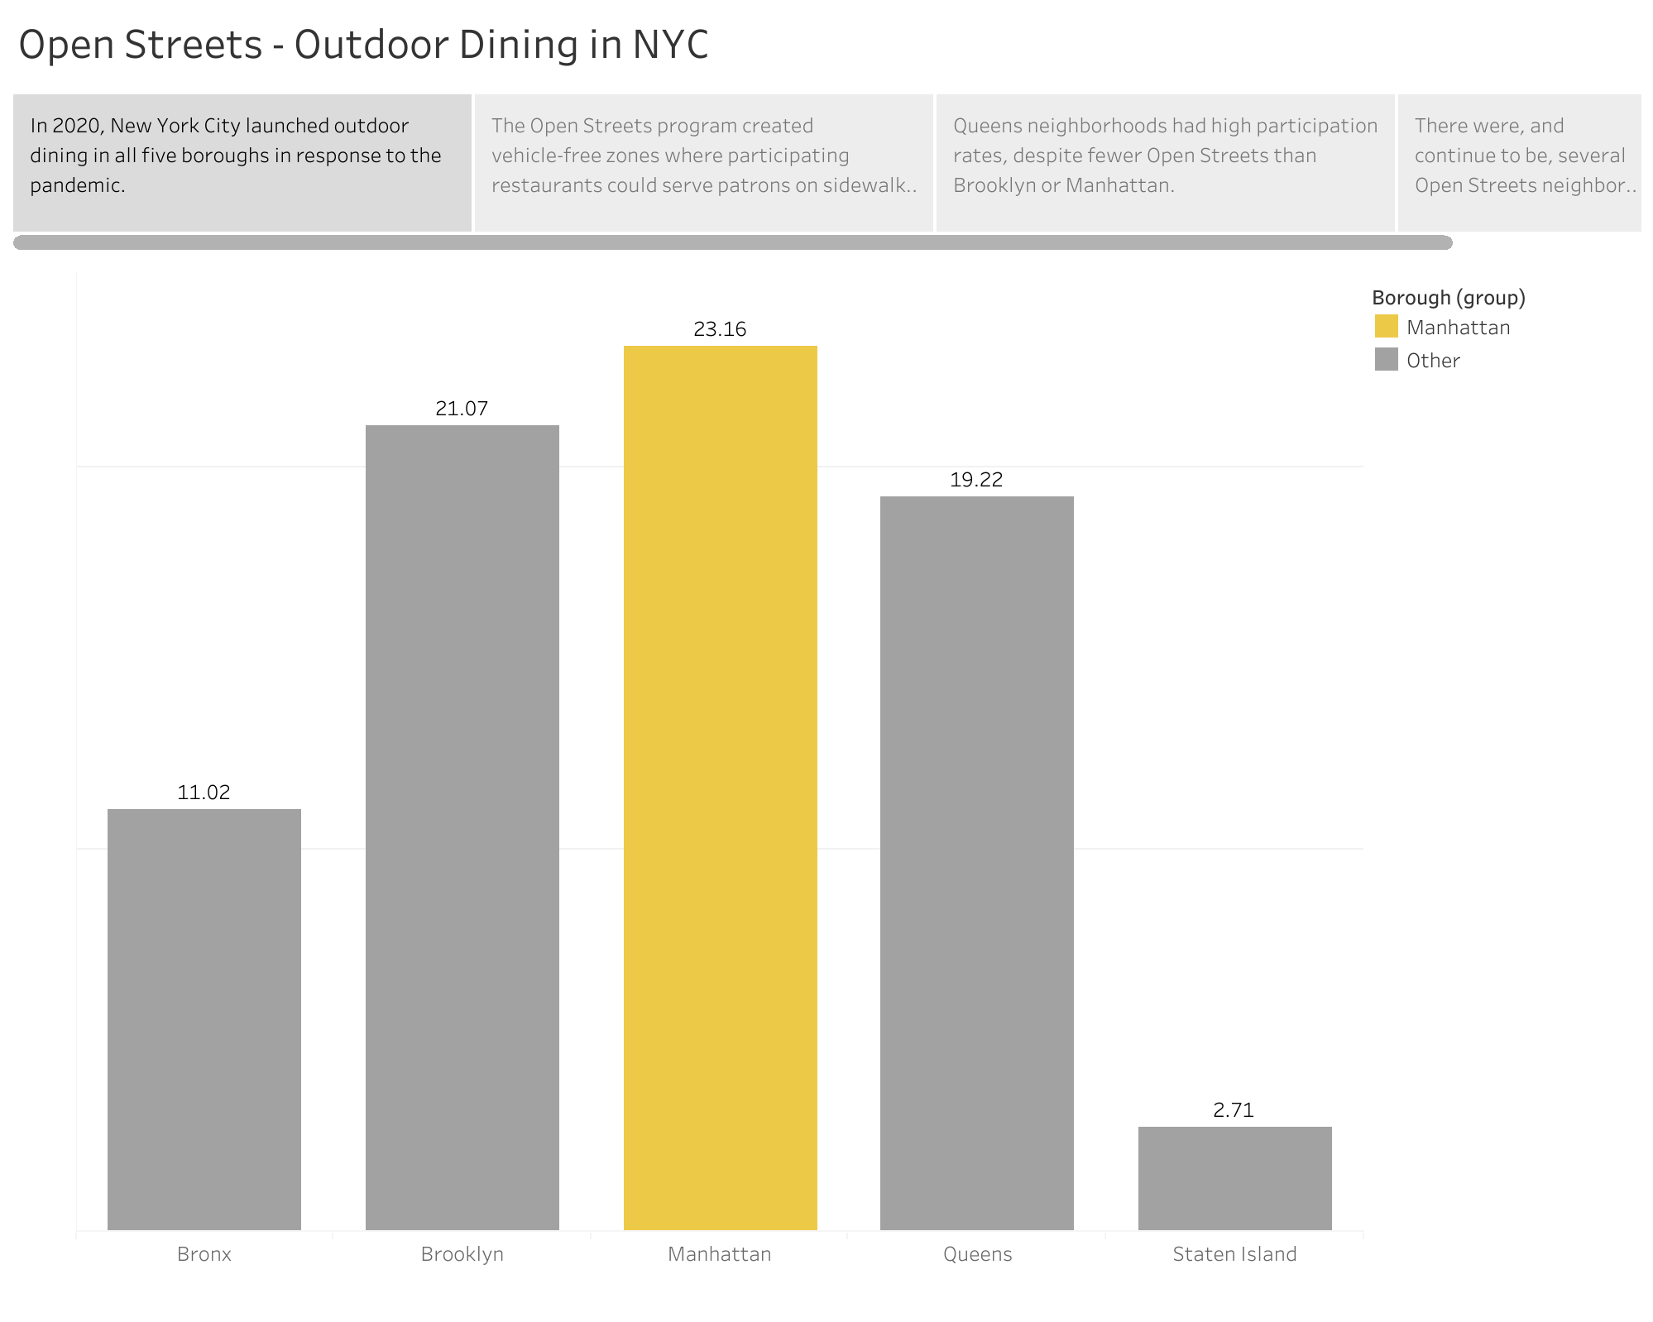

Slide 3
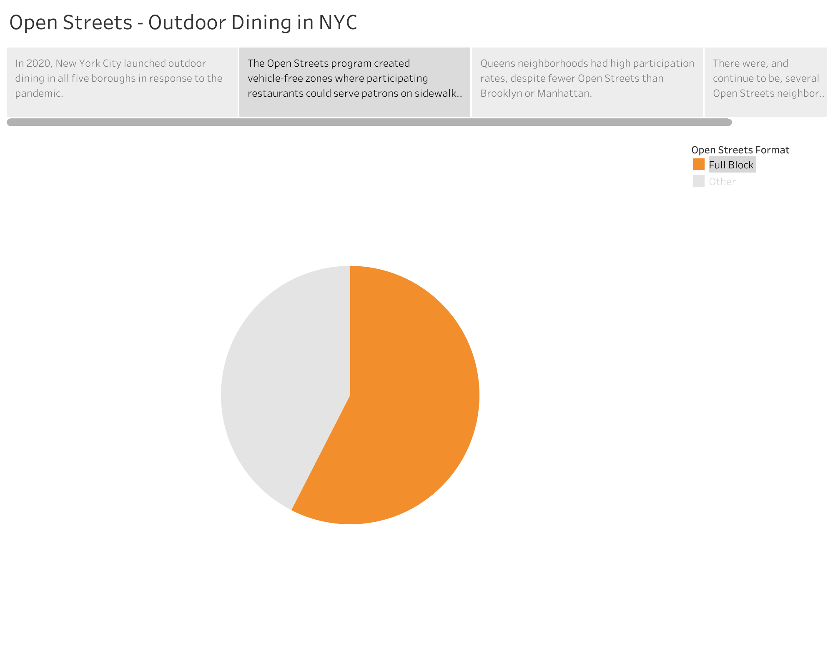

Slide 4
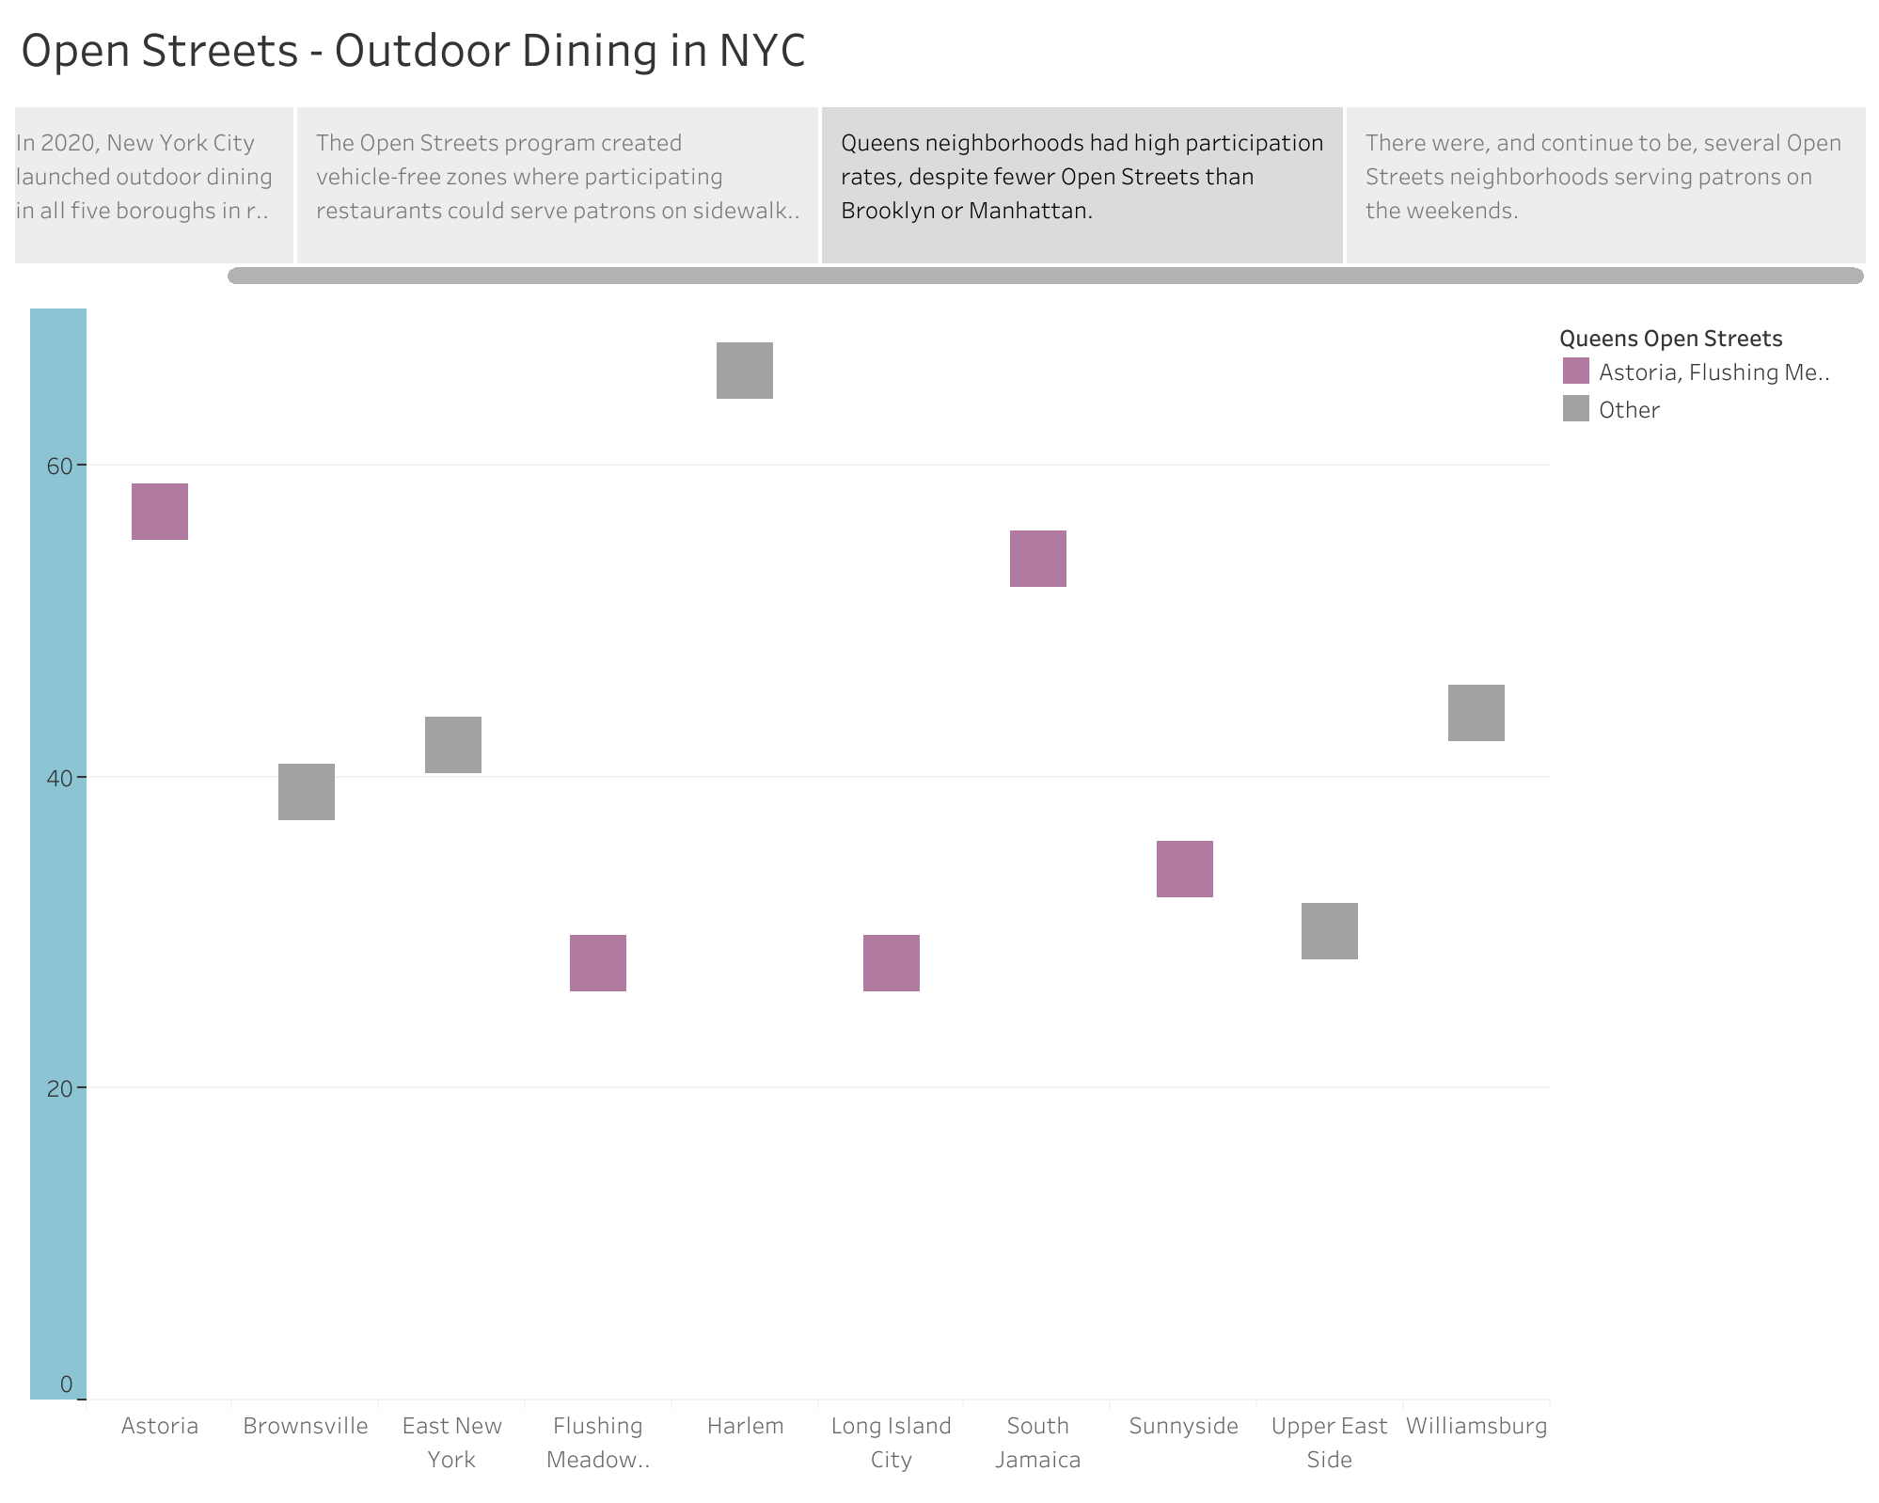

Slide 5
